Slide 1
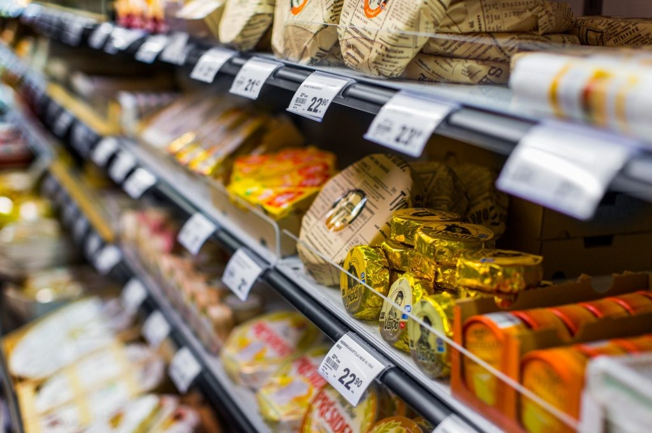
Acquisition
Acquirer: Valio Oy
Company Purchased: Heinon Tukku Oy
DEAL FACTS
Date
Type of Transaction
Sector
Deal Value
Global M&A Partners
June 30th, 2021
Acquisition
Food and Beverage
-
Aventum Partners (Finland)
THE TRANSACTION AND GMAP’S DEAL INPUT
ABOUT HEINON TUKKU OY
Valio Ltd is a Finnish manufacturer of dairy products and one of the largest companies in Finland. Valio's products include cheese, powdered ingredients, butter, yogurt and milk. It is Finland's largest milk processor, producing 85% of the country's milk.
The acquisition of Heinon Tukku is a natural step for Valio whose strategic goal is to be a pioneer in food solutions. The trend of eating out and takeaway is forecast to return to a growth trajectory as the coronavirus pandemic eases and Valio aims to become an even broader partner for restaurant and café professionals.
Aventum advised Tukkuheino Oy and other owners on the sale of Heinon Tukku to Valio.
Heinon Tukku has been operating for more than 120 years and is today one of Finland’s largest wholesalers serving professional kitchens. It is located in HELSINKI, Uusimaa, Finland and is part of the Grocery and Related Product Merchant Wholesalers Industry
It has over 100 employees at this location and generates $201.29 million in sales. They are the supplier of a total of about 30,000 products. Fresh foods account for most of the products; as well as industrial products like beverages, frozen products, cooking utensils and tableware.
GLOBAL M&A
About Global M&A Partners:
Established in 1999, Global M&A Partners is a leading international partnership of investment bankers specializing in mid-market transactions. We provide sector expertise, international scope, and deep local market knowledge and execution capabilities for our clients. We operate with local offices across 4 continents and have completed over 1,500 transactions during the last ten years, typically ranging from €50 to €500 million.
www.globalma.com
CONTACT:
Finland: Aventum Partners
Heikki Palmroth
+358 9 6850 2211j
heikki.palmroth@aventum.fi
https://aventum.fi//

